Slide 1


Impact of Social Sciences, Humanities and Arts Conference
Opening Session on:
Exploring (New) Pathways to Impact for SSHA
15 October, 2021

Slide 2
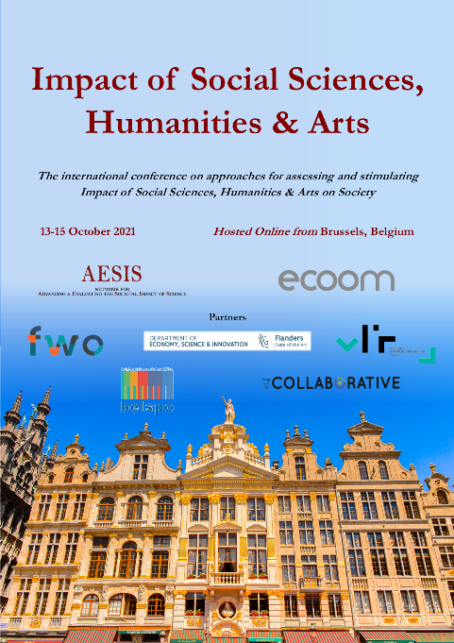

Impact of Social Sciences, Humanities and Arts
13-15 October, 2021
David Budtz Pedersen: Director of the Humanomics Research Centre, Denmark
Wendy Larner: Provost, Victoria University of Wellington Te Herenga Waka, New Zealand
Karen Maguire: Head of Division Local Employment, Skills and Social Innovation, OECD
Overview of the Keynote Speakers
#SSHA21

Slide 3
Impact of Social Sciences, Humanities and Arts
13-15 October, 2021
David Budtz Pedersen
Director of the Humanomics Research Centre, Denmark
#SSHA21

Slide 4

@HumanomicsMap
Impact through
Knowledge Brokering
David Budtz Pedersen PhD
Professor of Science Communication
Aalborg University Copenhagen
15th October 2021
AESIS Impact of SSHA Conference | Online from Bruxelles

Slide 5




David Budtz Pedersen
Professor of Science Communication
Aalborg University
Head of Humanomics Research Centre
Science Policy Adviser, Danish Government
Chair of EU COST Expert Group on Science Communication
Knowledge Broker for Algorithms, Data and Democracy (2021-2030)

Slide 6
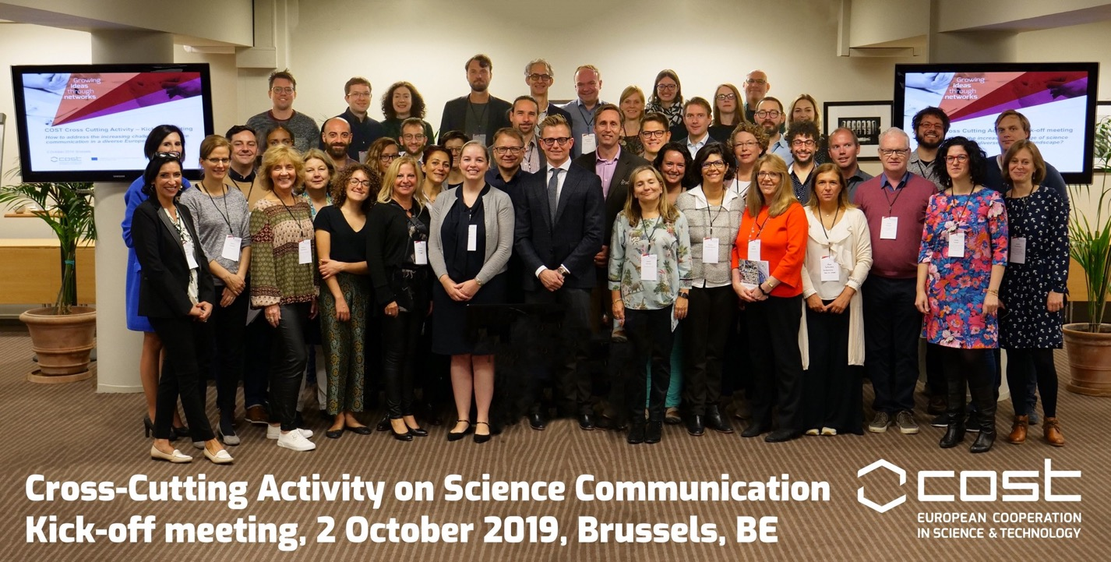

Slide 7
2021 Policy White Paper
Science Communication in Europe
Delivered to European Commission and European Parliament
Top-tier researchers in field of science communication
SSH essential part of response capacity

Slide 8
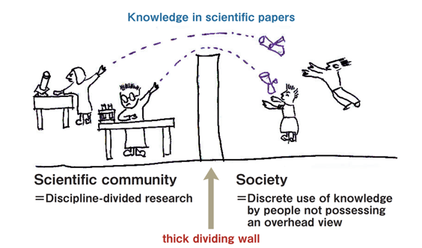
“
The value of research is only realized with communication and translation of results into real-world settings.
Without closing the loop, there is no beneficiary to all the tireless efforts put in by those dedicating their lives to the advancement of science.
Breanne Everett

Slide 9
… part of a broader change in the organisation of science policy
Need to foster dialogue, research uptake and implementation
Need to develop new formats for research dissemination & communication
Need to work across disciplines, public sector, industry and civil society to achieve societal missions and challenges (inter- & transdisciplinarity).
‘Social robustness’ of research means that end-users and stakeholders participate in creating research and impact (Mazzucato 2018)
Increased interest among funding agencies to foster “public value”
and document ‘broader impact’ of research (beyond bibliometrics)

Slide 10


Slide 11
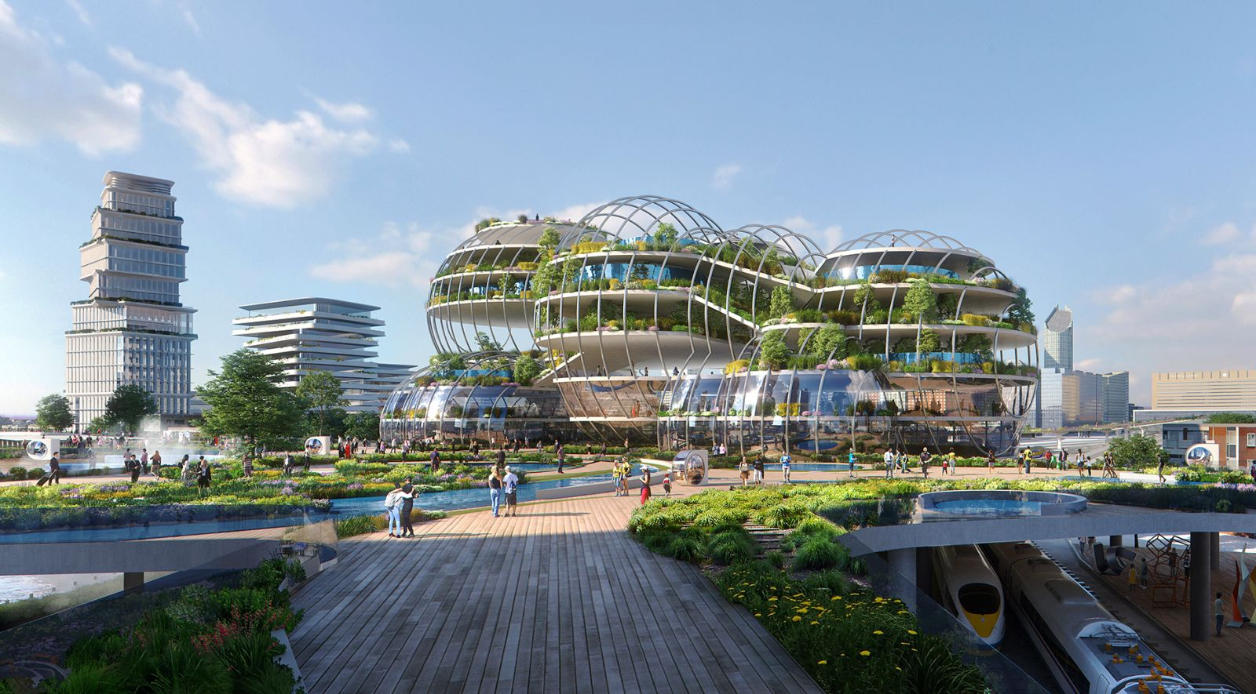


Slide 12
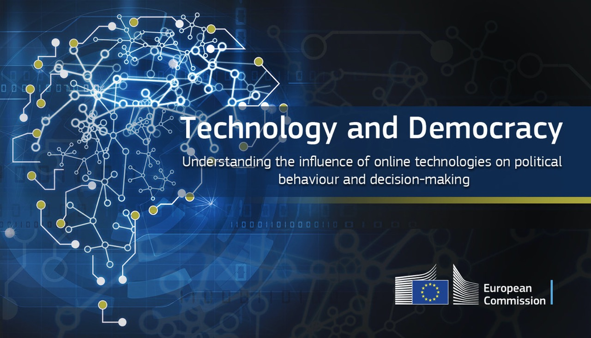

Slide 13
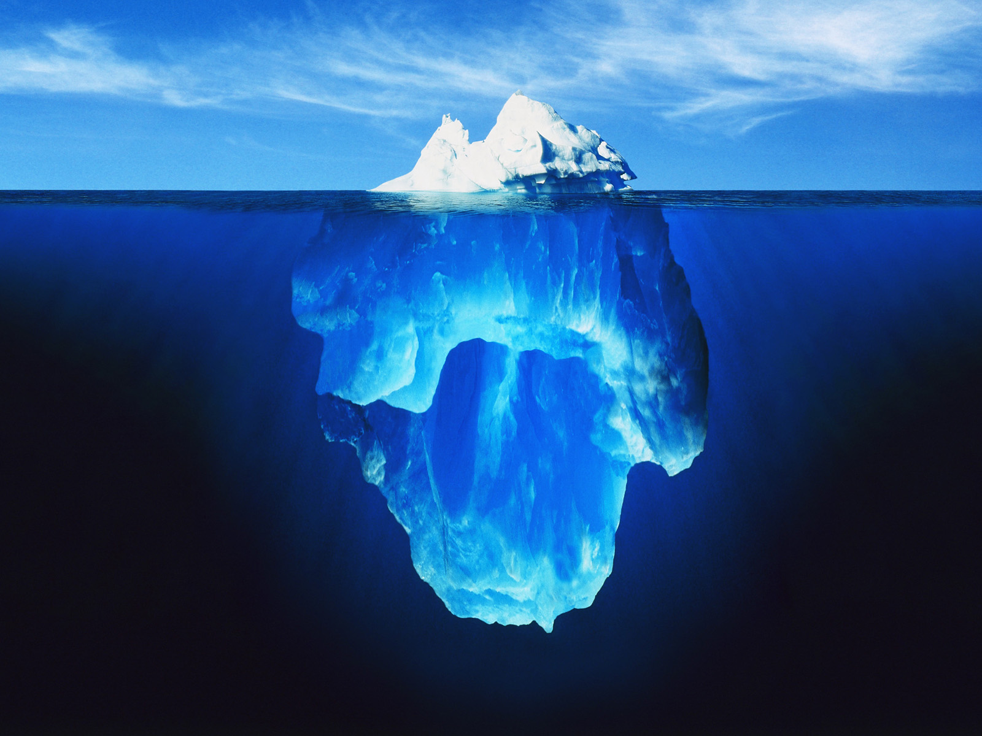
IMPACT OF RESEARCH
Education
R&D collaboration
Tech transfer (IPR, licenses)
Consutlancy
Advisory roles
Informal collaboration
Knowledge Exchange & Brokering
Science Communication

Slide 14
Research collaboration
Commissioned research
Technology transfer, patents (IPR)
Reports, advice, testimony
Participation, meetings, seminars
Specificity of impact
Brokering, input and day-to-day feedback
Knowledge Exchange
Budtz Pedersen et al. 2019
Humanities Impact Survey 1371 respondents

Slide 15
Knowledge brokering as an impact pathway

Slide 16
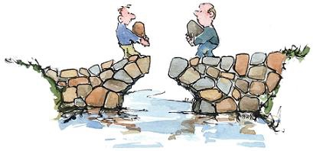

Knowledge brokers
“Knowledge brokering is an umbrella term for a process in which a person, group or organization take on the professional responsibility to support the translation and exhange of knowledge between researchers, practitioners and decision-makers , and/or contribute to the interpretation and adaption of research knowledge in a user context.”
(CHRSF 2003; Ward)

Slide 17
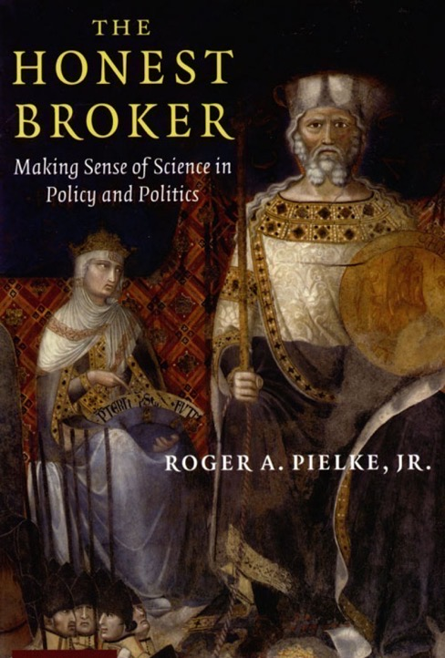
SSH Knowledge brokering
Evidence-informed policy-making is a key resource when addressing societal challenges such as climate change, pandemics, digitalisation, migration, security etc.
Hard facts (benefits & risks e.g., for the environment, eco-system, animal and human health, food security, infrastructure etc.) are embedded in … soft context (e.g., economic, political, behavioural, legal, ethical, demographic).
Need for interdisciplinary knowledge brokering (e.g., Covid-19) to provide knowledge in context of political and social values.

Slide 18
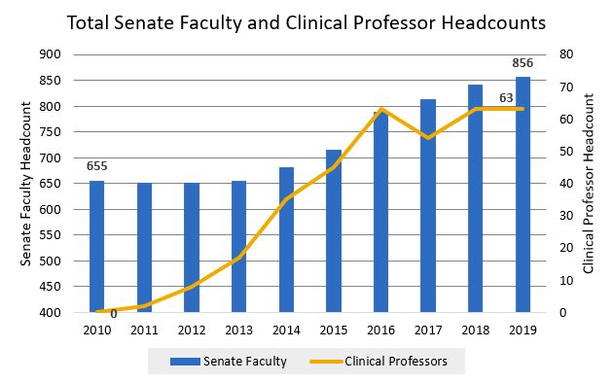
Knowledge brokering
Different ways of producing tangible societal impact
Productive interactions with society: joint appointments, consultancy, partnerships, networks, co-creation, facilities, start-ups, fellowships, etc.
New positions tailor-made for implementation research: “clinical” professor (knowledge brokers).
University of California

Slide 19
The K* spectrum
Informational functions
Relational functions
System functions
Informational intermediary
Knowledge
intermediary
Knowledge
broker
Change
agent
Enabling access to information from one or more sources
Helping people make sense of and apply information
Improving knowledge use in decision-making; fostering the co-production of knowledge
Influencing the wider context to reduce transaction costs & facilitate innovation
Linear dissemination of knowledge from producer to user
Co-creation of knowledge, social learning & innovation
Harvey, Lewin & Fisher 2012 & Fisher 2011

Slide 20






ADD Knowledge Broker
Policy Lab should:
Engage
Activiate
Concept development
Co-creation
Enhance knowledge
Deliver inspiration to researchers
Policy Lab
Professional Associations
Public Sector
Policy-Making
Civil Society
Research & Education
Media
Tech companies and industry
International trends and stakeholders
Establishing an alliance/network for ALGORITHMS, DATA & DEMOCRACY” –
across stakeholders
Methodology:
Participatory workshops, expert testimonals etc. in dialouge with stakeholder alliance

Slide 21
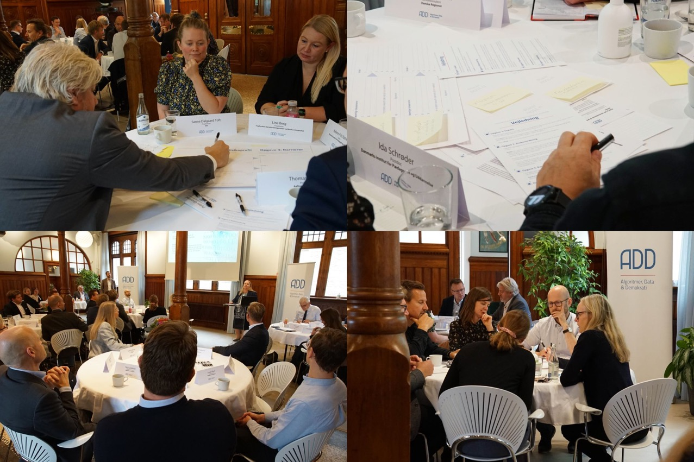
Dialog

Slide 22
Conclusions
Working together across silos to solve joint problems helps creating trust
Early engagement and co-creation with stakeholders to understand knowledge needs
Providing data within trusted knowledge networks + guidance for translation and implementation
Actionable knowledge is infested with values: open discussion about outcomes, scenarios, decisions
Mediators, knowledge brokers and intermediaries needed to build bridges

Slide 23


Thank you for the attention
David Budtz Pedersen: davidp@hum.aau.dk
Twitter: @HumanomicsMap
Website: http://mapping-humanities.dk
Supported by

Slide 24
Impact of Social Sciences, Humanities and Arts
13-15 October, 2021
Wendy Larner
Provost, Victoria University of Wellington Te Herenga Waka, New Zealand
#SSHA21

Slide 25
Excellence, Equity and Impact in Aotearoa New Zealand
Professor Wendy Larner FRSNZ FAcSS PFHEA
Provost, Te Herenga Waka—Victoria University of Wellington
Past President, Royal Society Te Apārangi
Co-Chair, PBRF Sector Reference Group

Slide 26
Te Herenga Waka—Victoria University of Wellington (2016-2021)
Began as Provost early in 2016
Major overhaul of Academic Promotions process
  More holistic conception of excellence
  Explicit acknowledgment of Māori and Pasifika knowledges
  Engagement
  Haututanga (leadership relative to roles and opportunities)
Five years later
  Numbers of senior academic women (Associate Professor/ Reader/ Professor) have increased from 87 to 122 (40% growth)
  Women Professors have increased from 39 to 50
  Pipeline is strong for women Associate Professor/Readers from 48 to 72
  Māori Professor/Associate Professor figures have also increased from 4 to 15

Slide 27
Equitable and Inclusive Environment
New Early Career development programme
Academic mentoring programme
Unconscious bias training
New Sexual Harassment Response Policy and Procedures
  Intimate and Personal Relationships Policy
New Equity, Diversity and Inclusion (EDI) Framework
Embedding of mātauranga Māori in research and curriculum
Active recruitment of Māori and Pasifika staff

Slide 28
Royal Society Te Apārangi (2017-2021)
Three Priorities
Enhancing equity and diversity in all its forms
  Better reflection of the increasingly heterogenous nature of our research sector
Building stronger relationships with Te Ao Māori
  Understand the past, present and future role of indigenous knowledges
Better support and recognition of early career researchers
  Engage with the priorities and experiences of a more diverse, more precariously employed, generation of researchers

Slide 29
Rethinking Research Excellence
Research excellence is more collaborative, more interdisciplinary and more engaged than often recognised
Rethinking research excellence has allowed us to better recognise the contributions of women, applied researchers and Māori and Pasifika researchers (2020 cohort of Royal Society Fellows was 50% Māori)
Has required stronger engagement beyond the universities, including with government scientists, independent research organisations and Māori organisations
More diverse and inclusive participation in all Royal Society activities

Slide 30
Rethinking Research Excellence and Impact
Changing who we are and how we do things, including building cultural and linguistic confidence
Developing reciprocal and mutually respectful relationships well beyond traditional academic networks
  Tuia 250
Bringing our expertise to bear on issues of wider concern to the New Zealand public
  New Zealand School curriculum
  Early Career labour market
  Covid, Plastics, Inequalities

Slide 31
PBRF Sector Reference Group (2021-23)
PBRF is New Zealand’s national research assessment exercise
Next PBRF round is in 2025
Government has agreed important changes to PBRF
  A more holistic approach to recognising and rewarding research and research excellence
  Better reflection of the partnership between Māori and the Crown
  Recognise and build the growing diversity of the research community in New Zealand
  Address inequities in different aspects of the tertiary research, research assessment and amongst researchers themselves

Slide 32
New Principles for PBRF
Partnership: the PBRF should reflect the bicultural nature of Aotearoa New Zealand and the special role and status of the Treaty of Waitangi/Te Triti o Waitangi
Equity: different measures and resources are needed to ensure that the measurement of research excellence leads to equitable outcomes
Inclusiveness: the PBRF should encourage and reflect the full diversity of epistemologies, knowledges and methodologies to reflect Aotearoa New Zealand’s people

Slide 33
Implications for Excellence, Engagement and Impact
Definition of research excellence should encompass the production of research, engagement and impact relating to that research
Research excellence should support vibrant, diverse and inclusive research cultures
Rather than simple categorisations such as basic or applied, traditional or non-traditional, we need to find ways to draw out the richest examples of research excellence across production, engagement, impact and support for research cultures

Slide 34
Conclusion
High quality research, information and knowledge are crucial to better economic, environmental and social outcomes
Need a research sector that better reflects our wider communities
Will require us to rethink excellence, foster new relationships, and enhance impact
Interdisciplinarity and epistemological diversity are increasingly important in this changing research landscape
Equity, diversity and inclusion will enhance impact
Aim is a more just environmental, economic and social future

Slide 35
Impact of Social Sciences, Humanities and Arts
13-15 October, 2021
Karen Maguire
Head of Division Local Employment, Skills and Social Innovation, OECD
#SSHA21

Slide 36
Social impact measurement for policy:
Examples from social economy, culture AND GLOBAL EVENTS/Local Development
Karen Maguire
AESIS 15 October 2021

Slide 37
Policy push to do more social impact measurement
Greater emphasis on outcomes/impacts due to political, consumer, and investor imperatives
Bottom up desire to know how to do better (civil society/ social economy, firms)
Continued efforts for improving budget allocation tools in public management (estimating rationale for expenditure/tax benefits, innovative tools such as social impact bonds)

Slide 38
Social Economy

Slide 39
What do we mean by social impact measurement?
“Social impact measurement aims to assess the social value and impact produced by the activities or operations of any for-profit or non-profit organisation”
OECD/EU (2015)
SOCIAL
IMPACT
MEASUREMENT

Slide 40
Meeting the needs of SSE organisations
DECISION MAKING CYCLE
SPECIFIC OBJECTIVES
Improve Prove
Allocate resources to social value creation
Experiment and innovate
Foster participation and collaboration
Persuade and influence
EX ANTE IN ITINERE EX POST
Estimating
Planning
Tracking
Evaluating
Reporting
Reporting
Estimating
Evaluating
Planning
Tracking
Notes:
NATALIE
DESIGNING SIM
Just like any other business, SSE organisations have information needs all along their decision making cycle. However, they can struggle to find enough resources and skills to meet, on the one side, divergent external accountability demands and, on the other, to internally derive learning insight for their own operational improvement and scaling.
Moreover, because of their distinct business model, SSE orgs have specific learning objectives when engaging in impact measurement:
Effectively allocate resources to social value creation which is at the core of their business model (and not just accessory to it);
To be successful in the day-to-day pursuit of a social mission, they have to continuously improvise, experiment, innovate to stay relevant to the societal problems they aim to tackle.
This has also been referred to in the literature as “social bricolage”
Increase participation and collaboration both external and internal, because they work with diverse stakeholders and pursue inclusive governance principles;
Finally, they need impact evidence to support their public and political advocacy activities.
These specific expectations may not be fully reflected in the choice of impact methodologies, especially when these are determined by external funders.

Slide 41
Some of the challenges….
What is the issue?
Adherence to social mission
What is needed?
Clarify the concept and practice of social impact measurement
What will the Global Action do?
Explore current social impact measurement practices
Mushrooming of methodologies
Not always coherent and adapted to the SSE
Promote a shared understanding
Encourage uptake in the SSE ecosystem
Understand how policy makers can help
Identify what methodologies are better suited to the SSE
Lack of a clear and agreed definition

Slide 42
Factors shaping social impact measurement practices
RESPONSE STRATEGIES
INTERNAL & EXTERNAL DRIVERS
Policy framework / enabling environment
Reject
Resist control & only symbolically comply
Governance and organisational culture
Funder requirements
INTERNAL
EXTERNAL
Purpose of assessing impact
Social and solidarity economy entity
Sector practices
Accept after resistance
Proactively adopt
Nature and complexity of the theory of change
Guidance
Available resources, both financial and non-financial
Notes:
IRENE
The defining features of SSE organisations (social mission, market orientation, inclusive governance) significantly affect their ambitions for and their capacity to implement impact measurement.
Both internal and external drivers prompt the adoption of IM by social enterprises. I’m not going to dwell on each of the factors listed here on the left, but just to mention a few:
Leadership and organisational culture. For instance, social enterprises often have a very diverse employee base, drawing from different professional, cultural and educational backgrounds (especially in the case of labour market integration of vulnerable groups). This may render the choice of measurement approaches more complicated, as groups will want to rely on practices they are more familiar with and find most legitimate.
Funder requirements: Impact investors, along with other public and socially-oriented funders, are among the most prominent factors prompting the adoption of IM by social enterprises. Research confirms that, when deciding on IM practices, social enterprises will typically prioritise funder requirements. Funders play an important role in driving the uptake of IM but also in determining which methodologies a soc.ent. will adopt.
Ultimately, the ambitions of any SIM endeavor will be inevitably influenced by resource availability.
As a consequence, SSE organisations may respond to these institutional pressures with diverse approaches, ranging from proactive and voluntarily uptake for learning and promotional purposes, all the way to complete resistance to external demands. Unfortunately, only the strategies here in green lead to benefits for the SSE organisations themselves. There is hence a sizeable risk that funder requests and harmonisation efforts may disenfranchise this type of actors, although they represent a primary lever when aiming for impact.
In this framework, public authorities have an important role to play to facilitate the production and exchange of impact evidence.

Slide 43
Debunking social impact measurement approaches
Identifying potential impacts
Counting outputs and beneficiaries
Collecting stakeholder feedback
Using standardised metrics
Measuring well-being
Populating predefined frameworks
Conducting impact evaluations
Valuing impacts

Slide 44




How can policy makers help?
Improve the
policy framework
(strategy, regulation, ring-fencing support)
Deliver guidance
(open-access manuals, adapted tools, harmonisation)
Foster evidence
(impact studies, repositories of knowledge)
Support capacity
building
(technical assistance, training, specialised intermediaries)
Notes:
IRENE
POLICY INITIATIVES
The GA aims understand what public initiatives can be pursued at the local, national and international level to foster IM, not just as a practice for individual social enterprises but as a culture more broadly for all actors in the SSE.
Our initial research shows that policy makers can undertake the following initiatives, I invite you to start thinking how they may apply in Canada:
Improve the policy framework across different policy instruments
Explicitly mention SIM in their strategies for SSE development
Issue regulation to enforce the implementation of social impact measurement. This can be linked to public procurement, but also to legal forms and statuses or as a necessary component of funding mechanisms for social innovation.
Ring-fence public resources to enable monitoring and evaluation by SSE organisations, less frequent unfortunately but always a component of EU funded projects
Foster the production, accumulation and dissemination of evidence,
by mandating impact studies,
creating repositories of knowledge (e.g. What Works Centers)
or simply disseminating available information
Deliver methodological guidance
Provide methodological open-access manuals, available for free
Take part in the design of bespoke social impact measurement tools tailored to SSE
Support the adoption and dissemination of harmonised standards (Government of Ontario in Canada with Common Approach)
Support capacity development, for instance by
delivering training and technical assistance
supporting networks and specialised intermediaries (incubators)
We would like to collect your experience, on what has been done so far in Canada and how public action could be improved. This work will culminate in the publication of international policy guidance by 2022.
Pass on to poll.

Slide 45
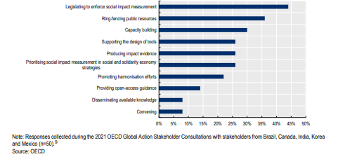
How is it happening?
Public initiatives implemented to promote social impact measurement in Brazil, Canada, India, Korea and Mexico

Slide 46
Global Events

Slide 47
OECD Recommendation on Global Events and Local Development
Adopted by the Council of Ministers on 30 May 2018

Slide 48
Approaches used for global events
Statistical modelling used to estimate economic impacts through general equilibrium effect or input-output methodologies
  Lack of granularity for specific places (local) or target groups, such as small and medium-sized enterprises or those in the social and solidarity economy; do not capture unintended effects
Experimental or quasi-experimental approaches deploy a counterfactual to quantify the causal effect that can be attributed to the intervention.
  Limitations: absence of comparable samples, as well as difficulties related to the endogeneity of indicators.
A theory-based approach where a theory of change needs to be formulated to outline how the intervention intends to reach its results and to assess the assumptions underlying the causal chain, from inputs to outcomes and impact

Slide 49
Culture

Slide 50

Culture: Great expectations
In addition to economic impact, looking to culture for:
Inclusion/diversity
Community engagement
Health and well-being
Pro-environmental behaviours
Skills for employment
Violence prevention/rehabilitation

Slide 51
Impact of Social Sciences, Humanities and Arts
13-15 October, 2021
Thank you!
#SSHA21

